Slide 1
Source Control Concepts with Git and GitHub
By Kevin Israel

Slide 2
Contents
Overview of Source Control
Source Control Concepts
GitHub
Git Basics

Slide 3
Overview of Source Control

Slide 4
What is Source Control
Source control (or version control) is the practice of tracking and managing changes to code. Source control management (SCM) systems provide a running history of code development and help to resolve conflicts when merging contributions from multiple sources.
As teams design, develop and deploy software, it is common for multiple versions of the same software to be deployed in different sites and for the software's developers to be working simultaneously on updates. Bugs or features of the software are often only present in certain versions (because of the fixing of some problems and the introduction of others as the program develops). Therefore, for the purposes of locating and fixing bugs, it is vitally important to be able to retrieve and run different versions of the software to determine in which version(s) the problem occurs. It may also be necessary to develop two versions of the software concurrently: for instance, where one version has bugs fixed, but no new features (branch), while the other version is where new features are worked on (trunk).

Slide 5
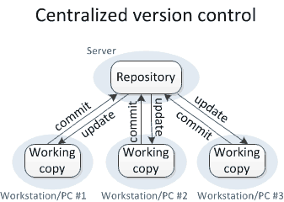
Centralized Source Control

Slide 6
Distributed Source Control
SC Server
Remote
Repo
Developer A
Developer B
Developer C
Local Repo
Local Repo
Local Repo

Slide 7
Source Control Concepts

Slide 8
Source Control Concepts
Branching
Merging
Metadata
Track changes
Check in/Check out
Authentication and Authorization

Slide 9
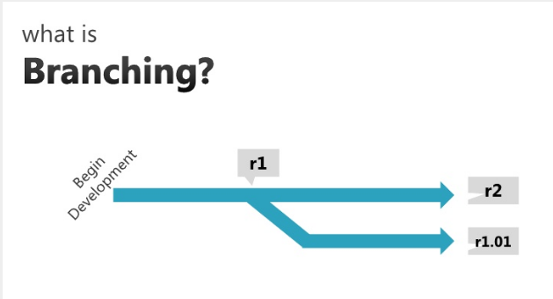
Source Control Concepts

Slide 10
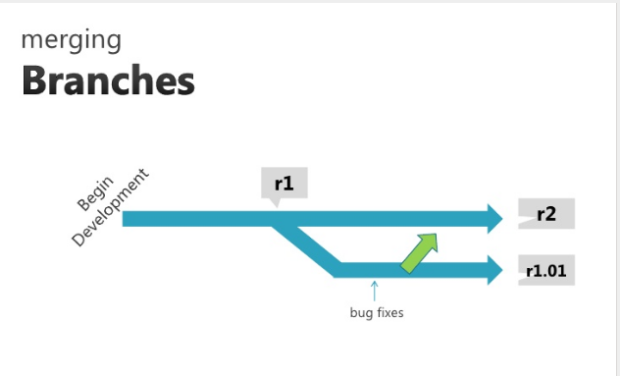
Source Control Concepts

Slide 11
GITHUB

Slide 12
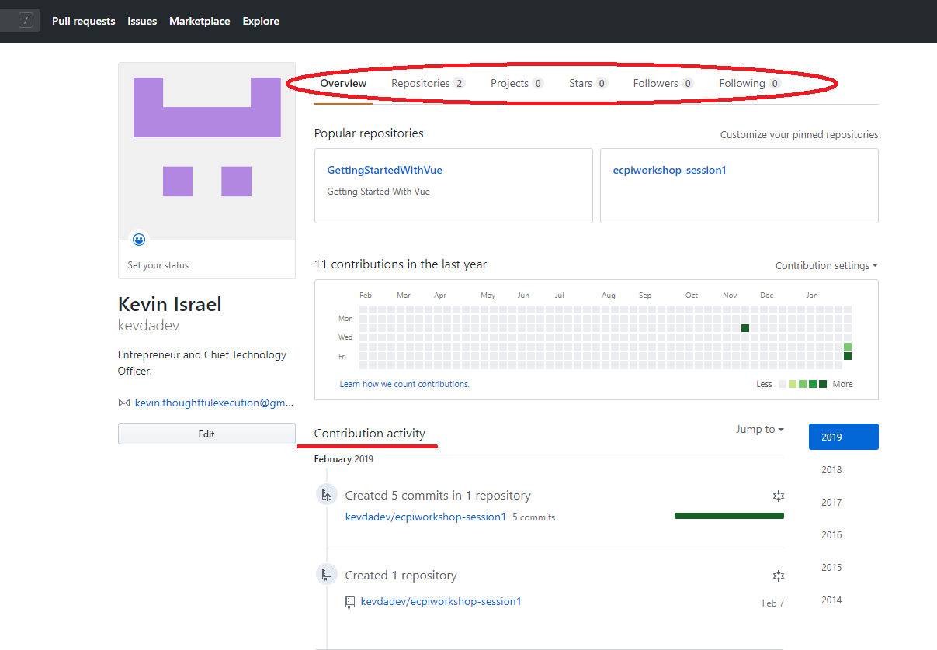
GitHub

Slide 13
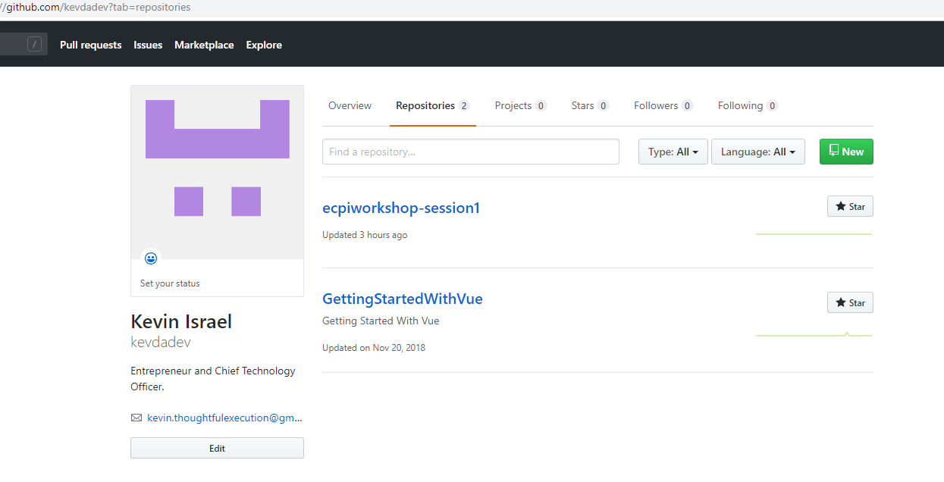
GitHub - Repository Portal

Slide 14
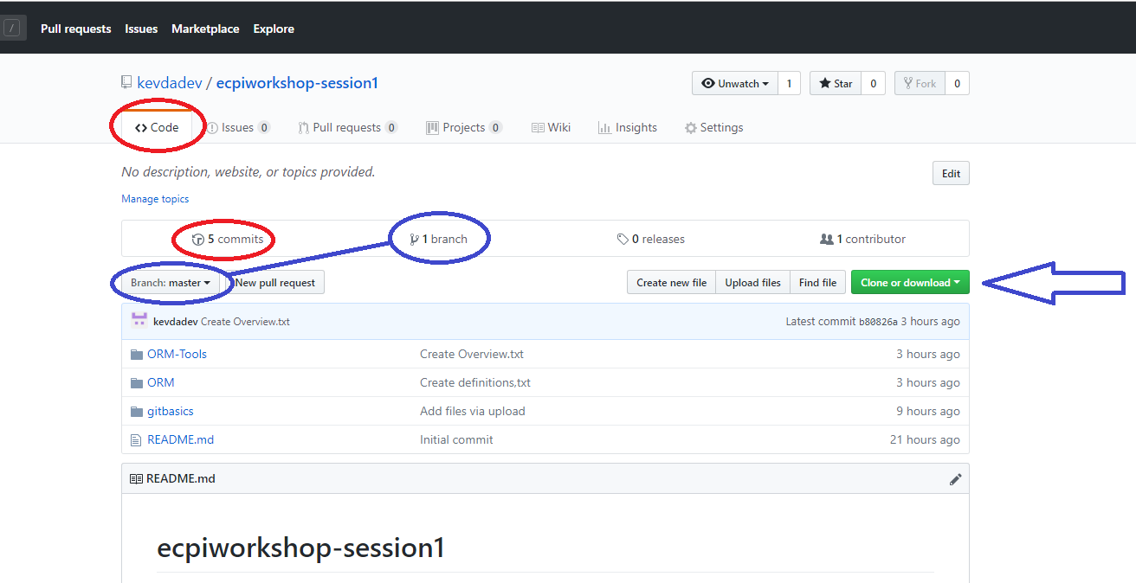
GitHub – Repository

Slide 15

GitHub - Projects

Slide 16
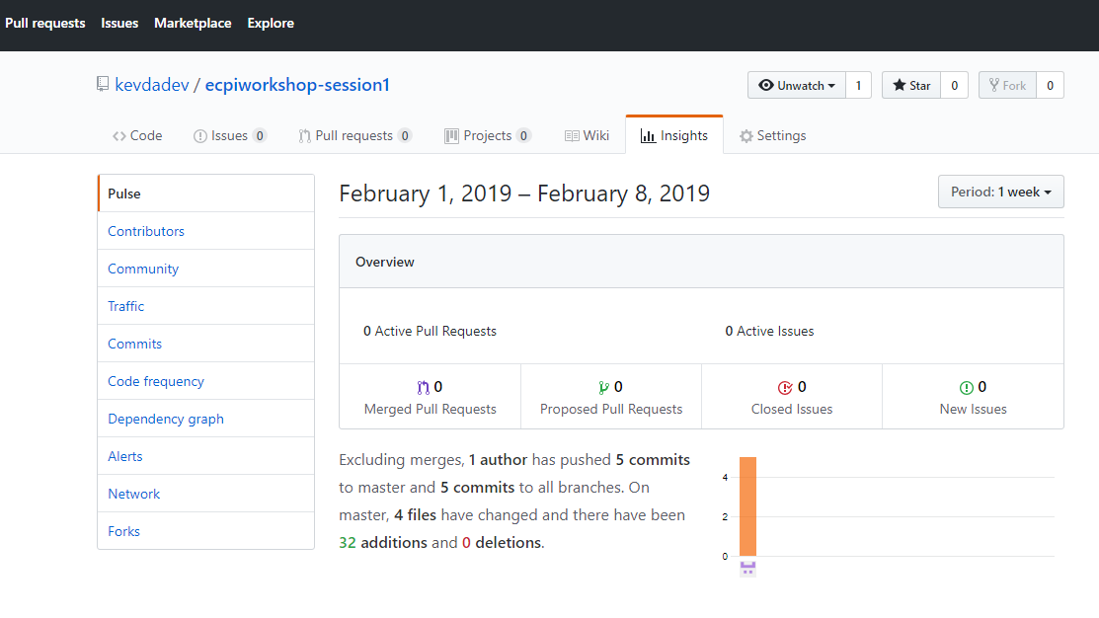
GitHub - Insights

Slide 17
GIT BASICS

Slide 18
Getting Started with Git
Distributed Version Control System: Git has a remote repository which is stored in a server and a local repository which is stored in the computer of each developer. This means that the code is not just stored in a central server, but the full copy of the code is present in all the developers’ computers. Git is a Distributed Version Control System since the code is present in every developer’s computer.
Download git
This link has details on how to install Git in multiple operating systems:
https://git-scm.com/book/en/v2/Getting-Started-Installing-Git
Linux
Windows
macOS

Slide 19
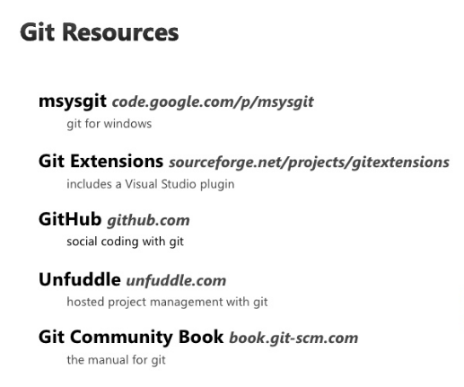
Resources

Slide 20
Summary
Discussion and Questions
Notes:
https://github.com/kevdadev/ecpiworkshop-session1

